Slide 1
MRA Project ML 1
Aaditya Desai
DSBA – Aug 20
aadidesai9@gmail.com

Slide 2
Agenda [Table OF CONTENT]
Problem Statement
Data Introduction
About the Data
EDA, Timely Trends and Inferences
RFM – assumptions and calculations
RFM workflow diagram using KNIME
Inferences

Slide 3
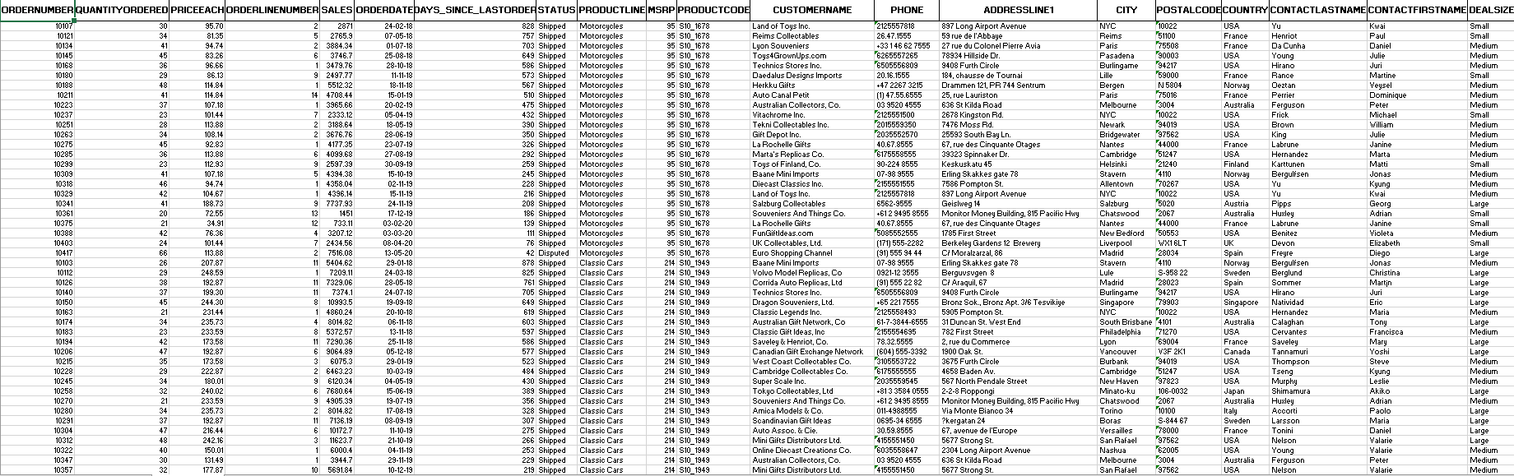
PROBLEM STATEMENT
The columns in the dataset are - ORDERNUMBER, QUANTITYORDERED, PRICEEACH, ORDERLINENUMBER, SALES, ORDERDATE, DAYS_SINCE_LASTORDER, STATUS, PRODUCTLINE, MSRP, PRODUCTCODE, CUSTOMERNAME, PHONE, ADDRESSLINE1, CITY, POSTALCODE, COUNTRY, CONTACTLASTNAME, CONTACTFIRSTNAME, DEALSIZE.
Following is a snapshot of how data looks like : -
An automobile parts manufacturing company has collected data of transactions for 3 years. They do not have any in-house data science team, thus they have hired you as their consultant. Your job is to use your magical data science skills to provide them with suitable insights about their data and their customers.

Slide 4
About data
The data is the given dataset is based on the information collected in the past 3 years. It has 20 columns and around 2750 line items about different customers, products, their last visits, orders, status of their orders, geographical data, deal size, etc.
The data has no missing values but still needs some computation to make it meaningful and derive some insights. So, we need to do some analysis , EDA, visualizations and perform RFM to derive the insights regarding the behavior of customer and their relationship with the manufacturing company.

Slide 5
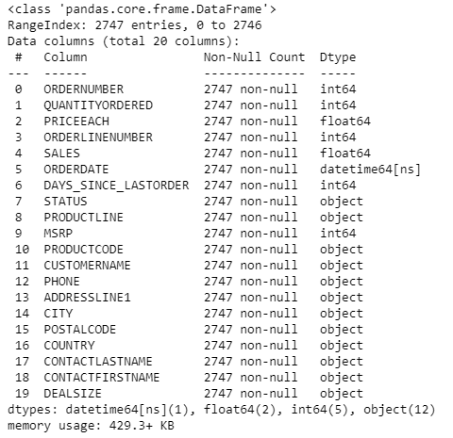
EDA information wrt non-null values, data types and column names using info()

Slide 6

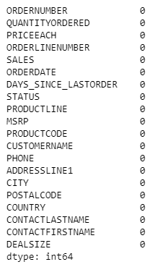
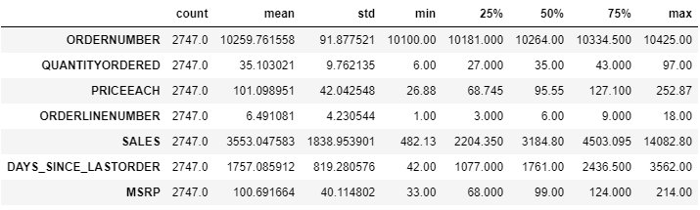
Size of data, Null values in all columns, 5-number summary of numerical data using shape, isna().sum() and Describe() respectively

Slide 7
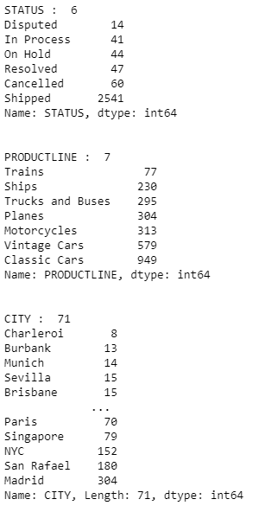
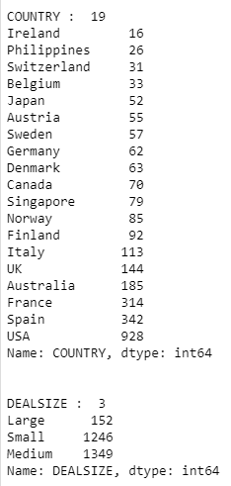
Description of categorical data- number of unique value, different values and its occurrences using nunique() , value_counts() and sorting by sort_values()

Slide 8
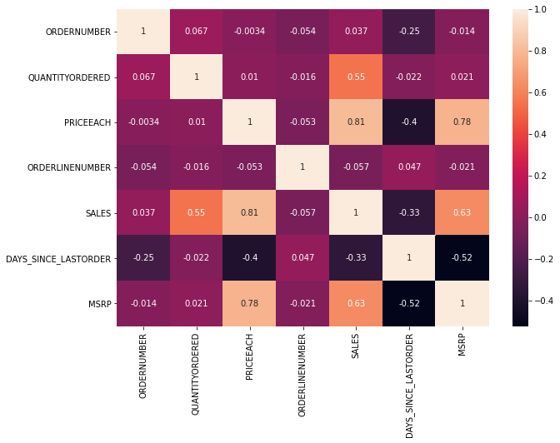
Correlation and heatmaps
Using corr() and seaborn library for plotting heatmap()

Slide 9
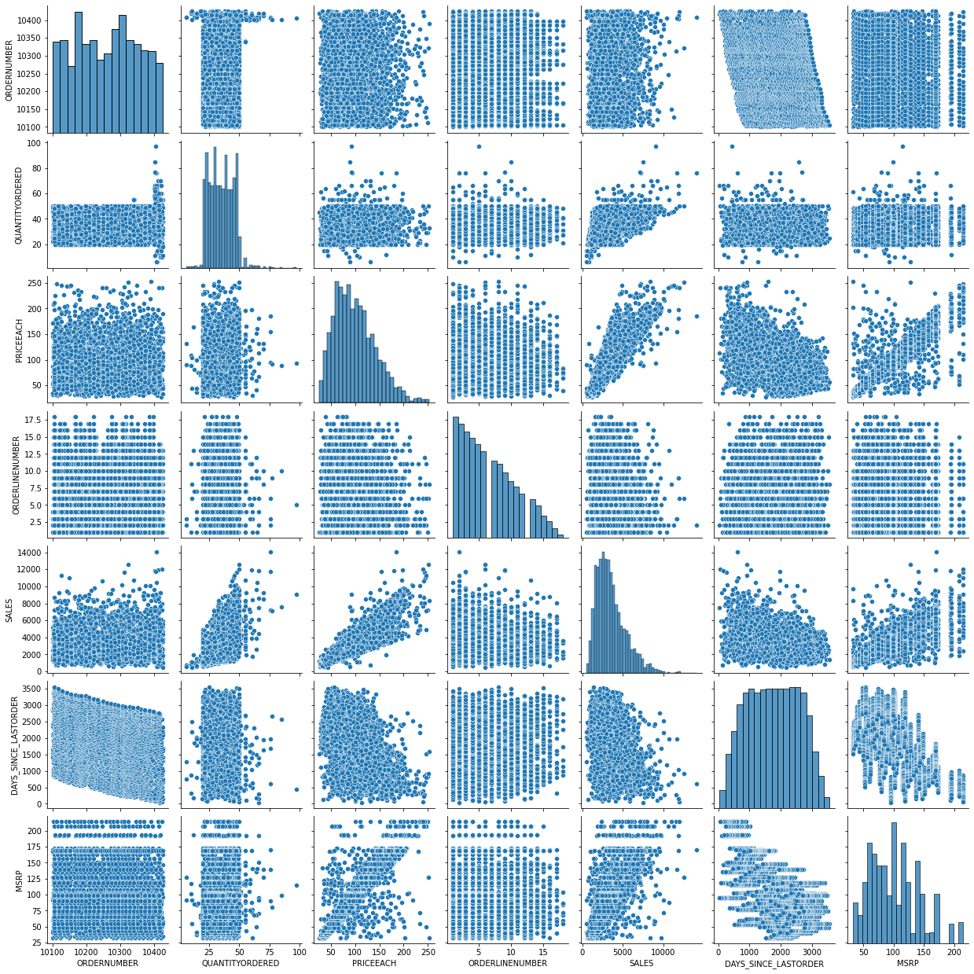
Pairplot
Using Seaborn library for plotting pairplot()
A pairplot shows distribution and relationship of one variable with respect to other variables.

Slide 10
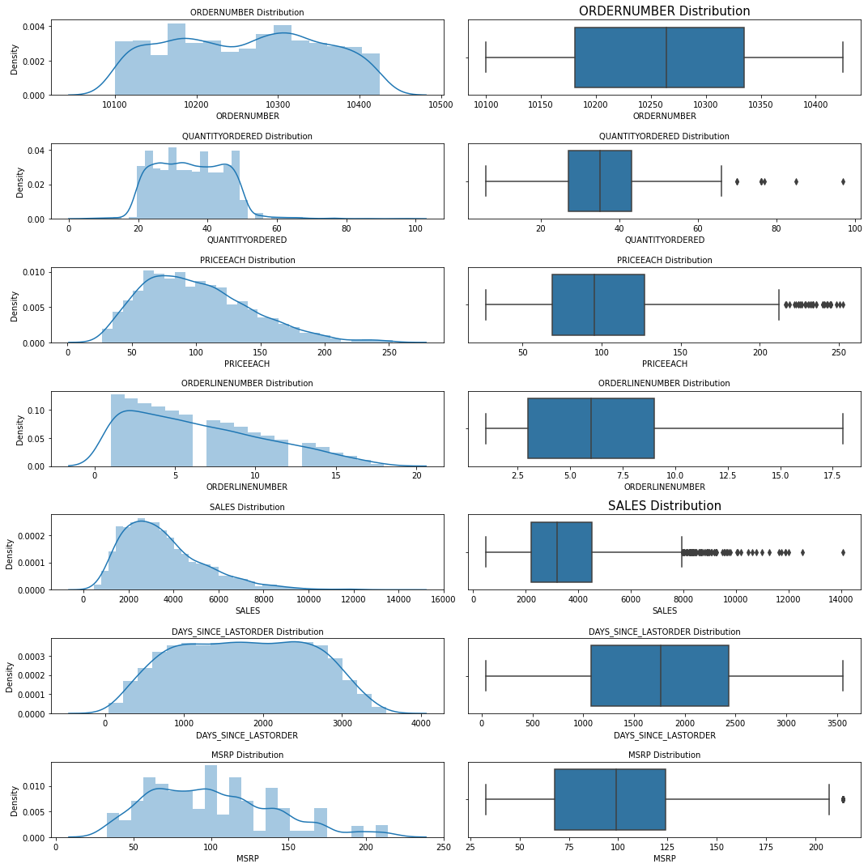
Distribution of data wrt numerical variables
We have used distplot() to show the distribution of data and boxplot() to show the 5- number summary and also check outliers

Slide 11
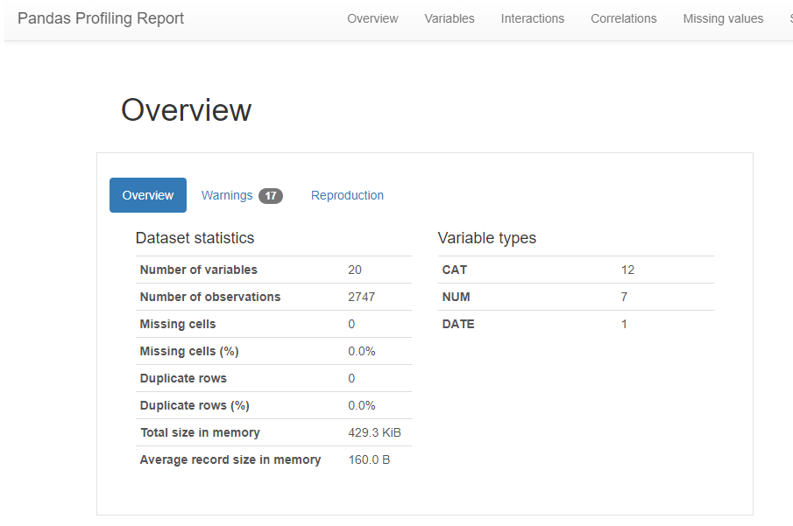
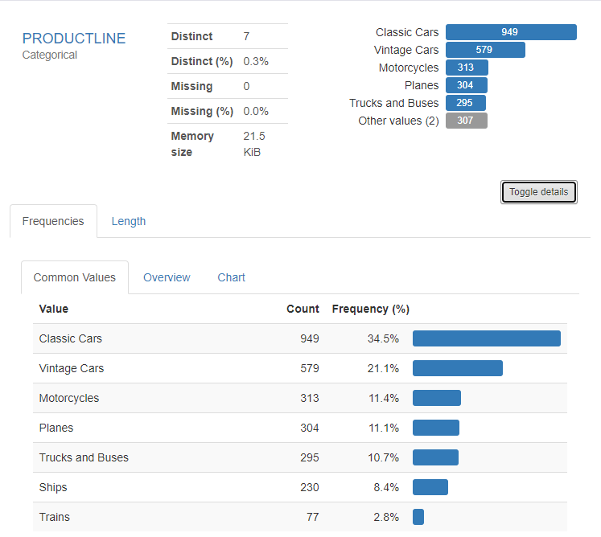
Pandas profiling
We use pandas profiling for overall analysis of the data, its distribution, eda and its visualization according to variables using profile_report()
Example – ProductLine variables in profile report : -

Slide 12
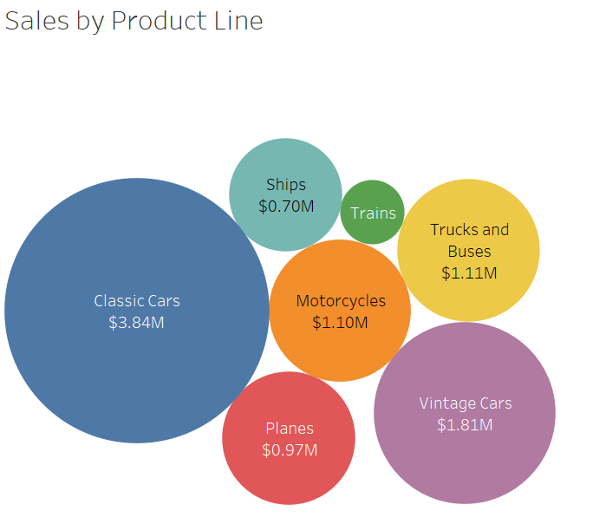
Visualization to see sales across different productlines
This is done using Tableau

Slide 13
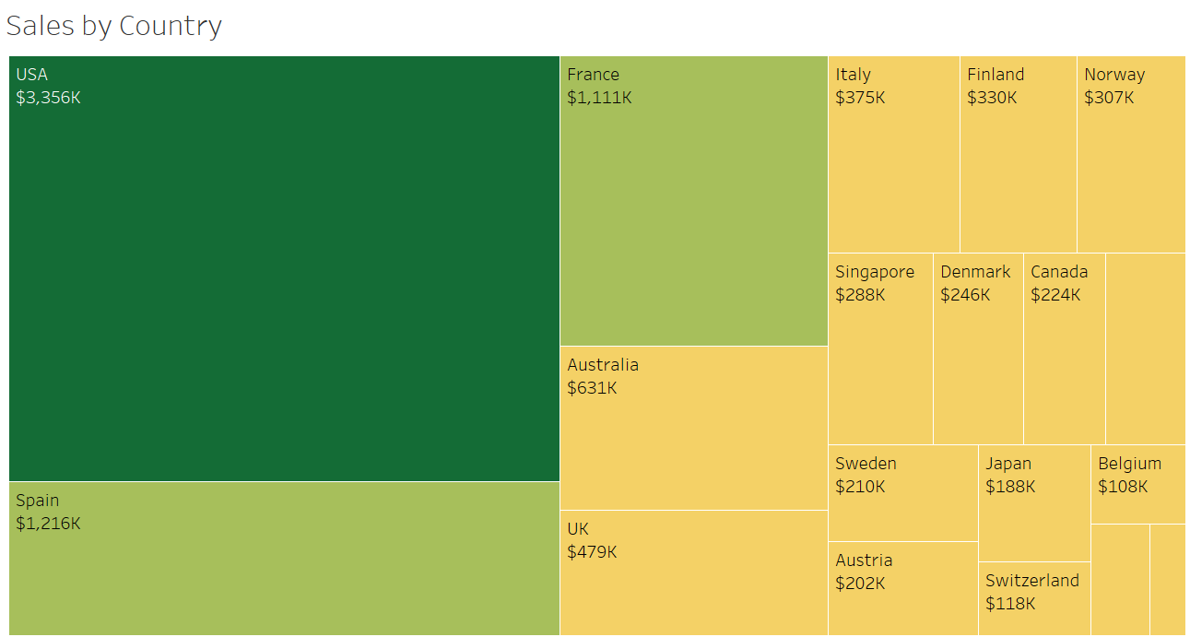
Sales across different countries

Slide 14
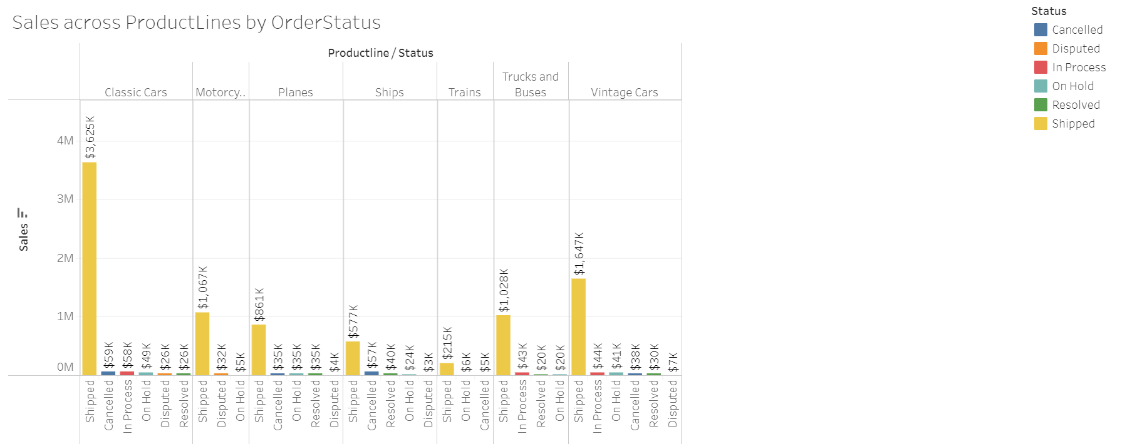
Sales across different categories and their delivery status

Slide 15
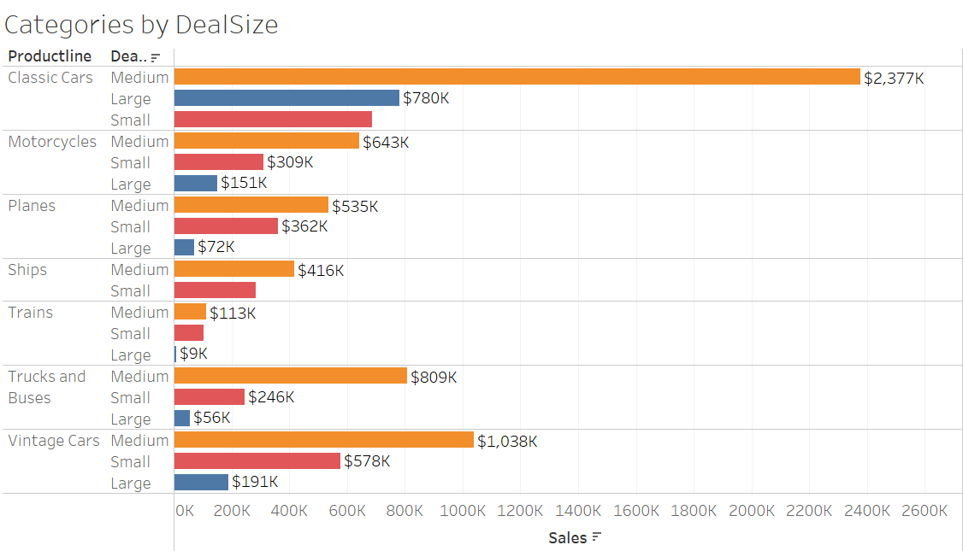
Categories by deal size

Slide 16
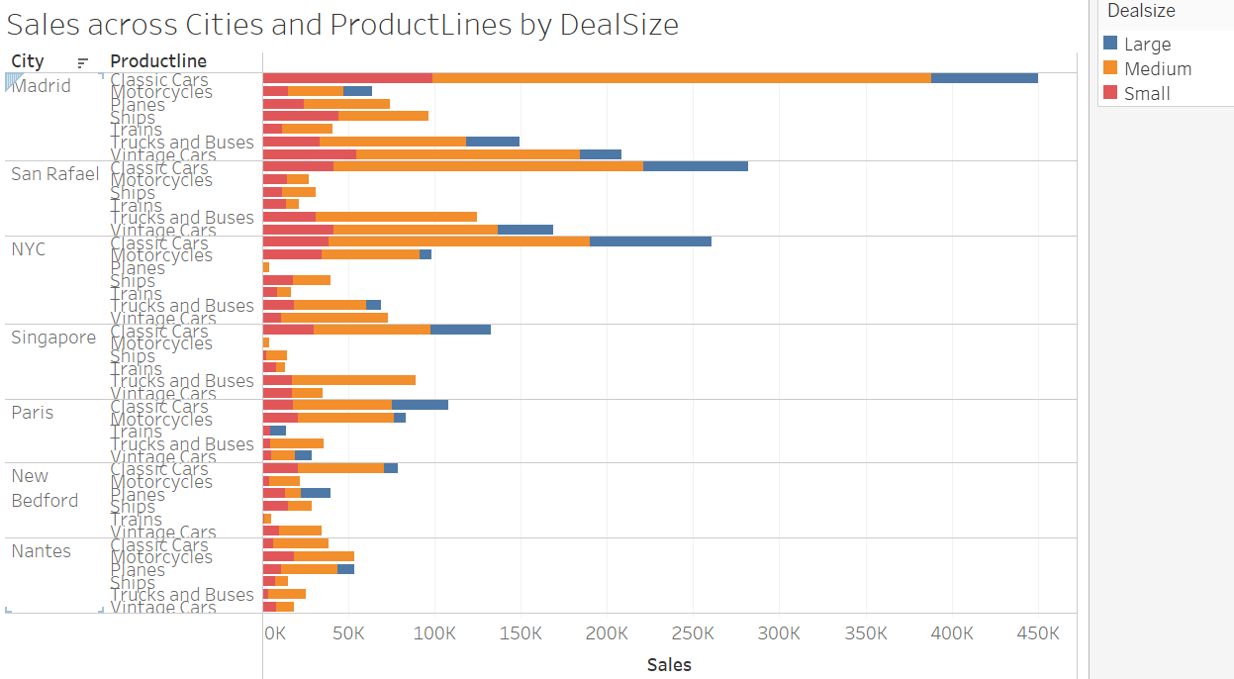
Top 7 cities wrt Sales and different categories

Slide 17
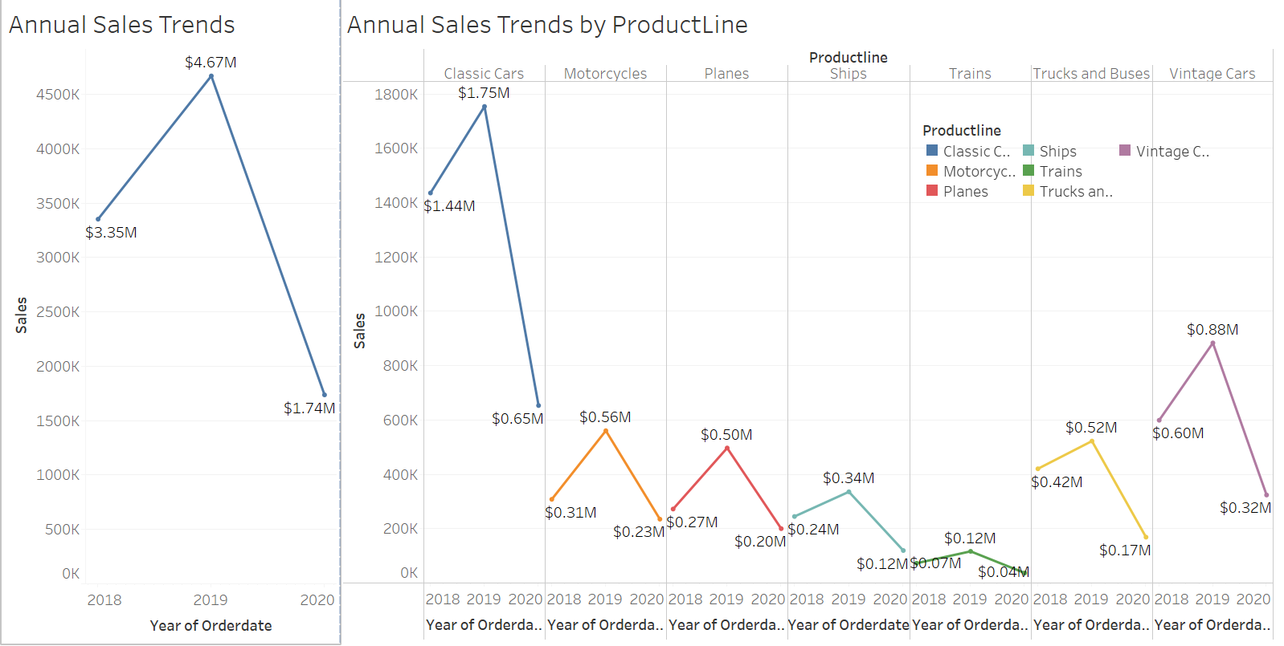
Annual trends

Slide 18
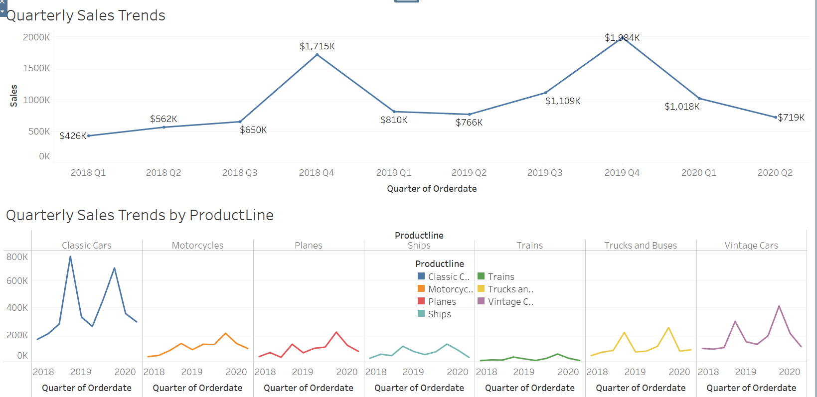
quarterly trends

Slide 19
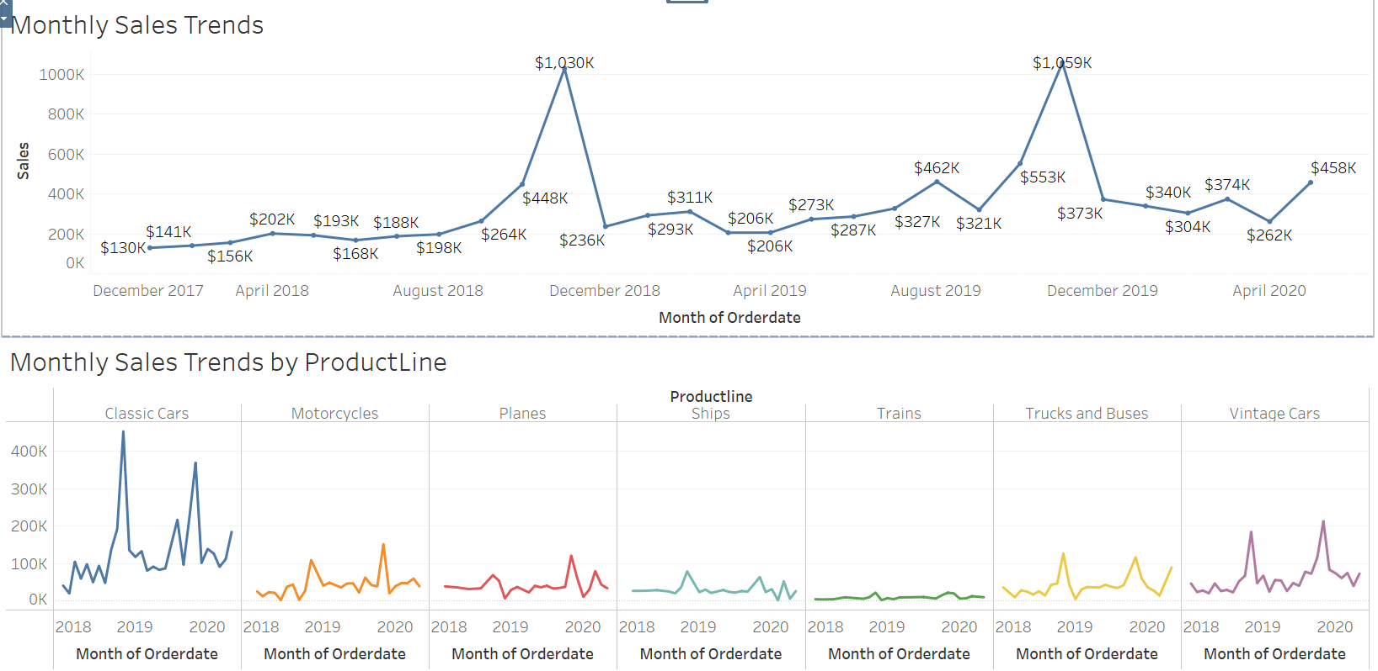
monthly trends

Slide 20
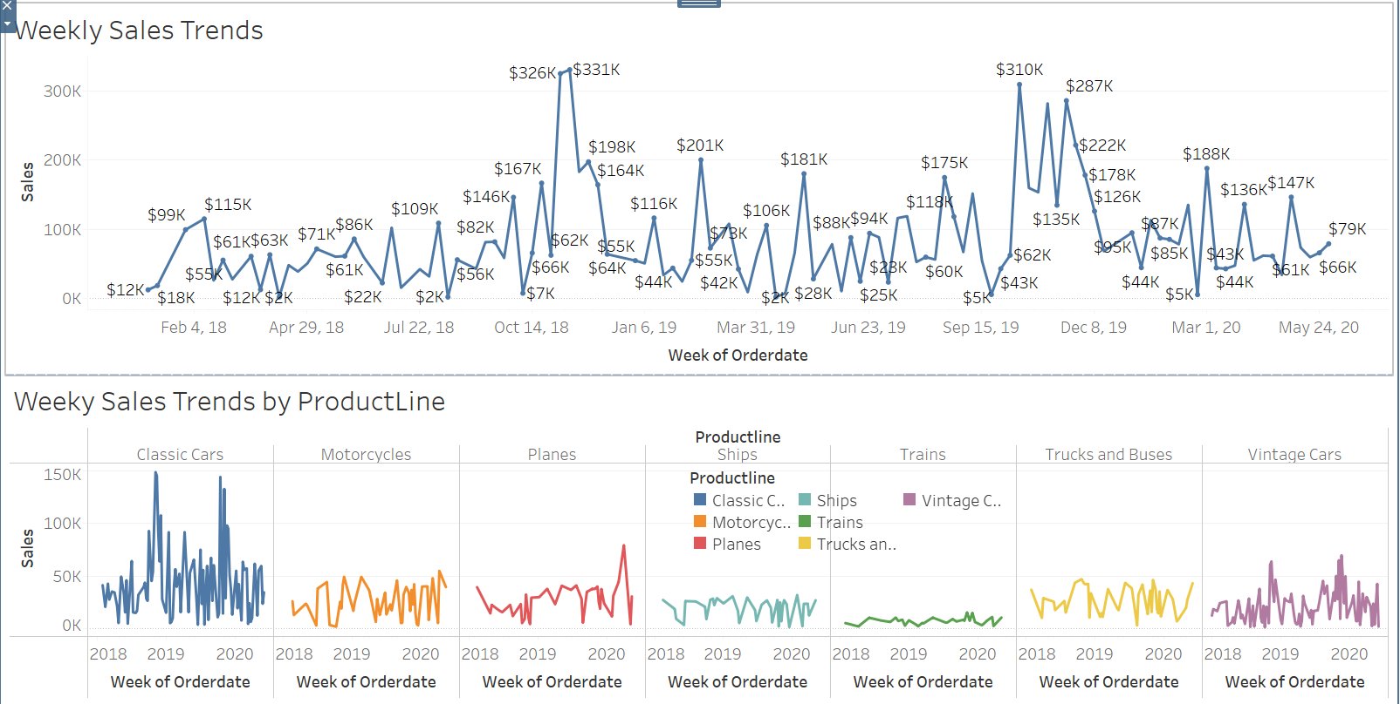
weekly trends

Slide 21
EDA inferences
For more clearer visualization, we can refer - https://public.tableau.com/views/Aadi_EDAforMRA/SalesacrossCitiesandProductLinesbyDealSize?:language=en-US&:display_count=n&:origin=viz_share_link
From the EDA, we can see that maximum sales is across Classic Cars categories and minimum is for Trains automobile parts over the period of 3 years.
USA, Spain and France are countries have maximum sales while Ireland, Phillipines and Belgium have lowest sales.
2019 had greater sales than 2020 and 2018 across all the categories, we can also notice that Q4 sales are drastically higher than the other 3 quarters.
The order status for most of the orders are shipped followed by Cancelled, OnHold, Resolved, InProcess and Disputed.
Most of the biggest deal sizes across all the categories are medium followed by small and then large.

Slide 22
RFM – recency, frequency, monetary
We have used KNIME to perform RFM Analysis.
RFM is Recency, Frequency and Monetary Analysis that helps to analyze the customer relationship with the organization and helps in deriving inferences like behavior, loyalty, churning, and customers that have already moved out.
We compute Recency by subtracting the current date – last ordered date and reading the results in days.
We compute the Frequency by grouping the data on customer level and counting the number of OrderNumbers.
We calculate the Monetary by multiplying PriceEach and QuantityOrdered.
We have binned RFM in 4 buckets- Very High, High, Low and Very Low where maximum values of Frequency and Monetary are in Very High buckets and least values in Very Low buckets whereas Minimum values of Recency (in days) lies in Very High bucket and Maximum values of Recency lies in Very Low bucket.

Slide 23
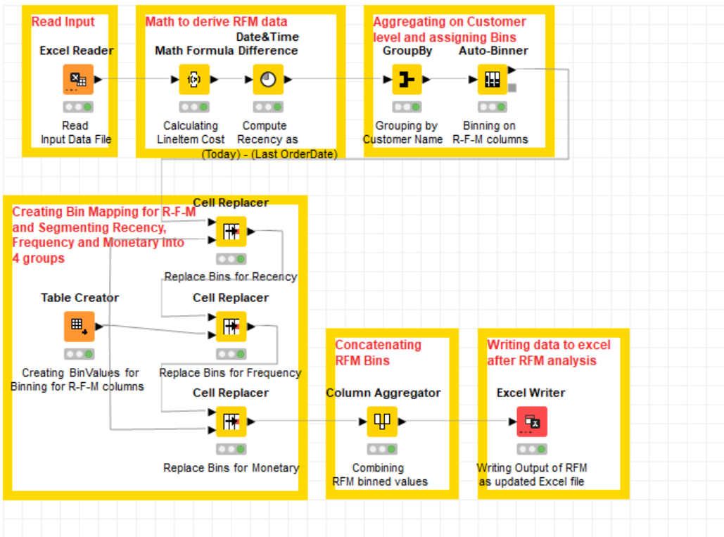
Rfm analysis – workflow diagram using knime

Slide 24
RFM in knime process
Read the input excel file.
Compute Monetary by Cost of Item * Quantity.
Compute Recency (current date – max(orderdate)) or min difference(current date – order date).
Grouping at customer level and calculating Frequency as count(order number) by customer.
Binning the RFM and replacing bin values and segmenting customers.
Aggregating RFM columns and then updating the columns in excel file.

Slide 25
Output of rfm analysis (first 5 customers)
Only the important/ necessary columns after RFM are shown.
CUSTOMERNAME | Frequency | Monetary | Recency(in days) | Frequency [Binned] | Monetary [Binned] | Recency [Binned] | Recency_FinalBins | Frequeny_FinalBins | Monetary_FinalBins | Concatenate
AV Stores, Co. | 51 | 157807.81 | 588 | Bin 4 | Bin 4 | Bin 3 | High | Very Low | Very Low | High|Very Low|Very Low
Alpha Cognac | 20 | 70488.44 | 456 | Bin 1 | Bin 1 | Bin 1 | Very Low | Very High | Very High | Very Low|Very High|Very High
Amica Models & Co. | 26 | 94117.26 | 657 | Bin 2 | Bin 3 | Bin 4 | Very High | High | Low | Very High|High|Low
Anna's Decorations, Ltd | 46 | 153996.13 | 475 | Bin 4 | Bin 4 | Bin 2 | Low | Very Low | Very Low | Low|Very Low|Very Low
Atelier graphique | 7 | 24179.96 | 580 | Bin 1 | Bin 1 | Bin 3 | High | Very High | Very High | High|Very High|Very High

Slide 26
RFM inferences – assumptions

Slide 27
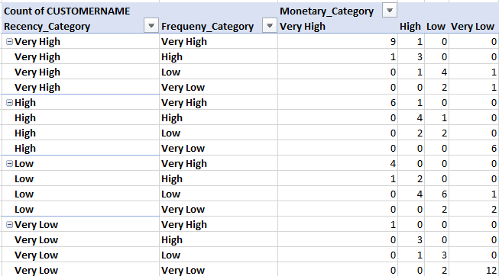
Observations and assumptions summary
Category | Sum of Count of Customers
Best and Loyal Customer | 14
Loyal Customer | 12
Churn | Important Customer | 11
Churn | 16
Stable Customer | 2
Opportunity for Potential Customer | 17
Lost Customer | 17
Grand Total | 89

Slide 28
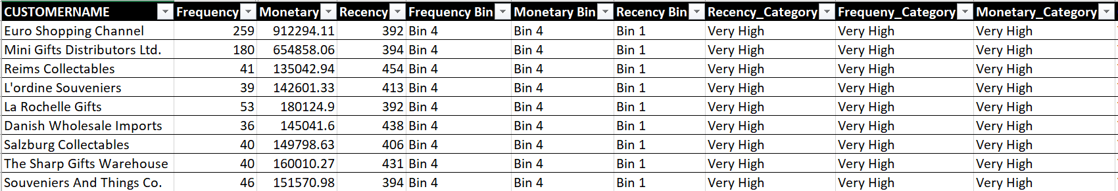
Who are your best customers? (give at least 5)
There are 14 customers that can be considered as the best customers.
This is because they lie in the Top buckets in all the 3 categories- Recency, Frequency and Monetary.
Some of them are : -

Slide 29
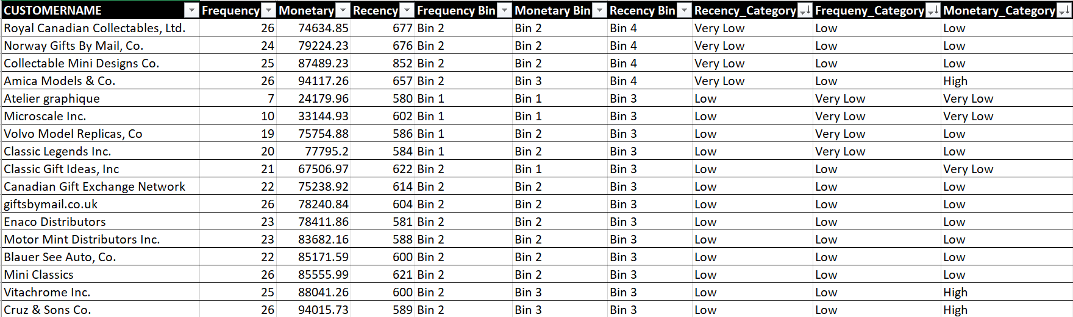
Which customers are on the verge of churning? (give at least 5)
There are around 27 customers on the verge of churning.
The behaviour they exhibit is their recency and frequency lie in bottom 2 buckets.
Some of them are : -

Slide 30
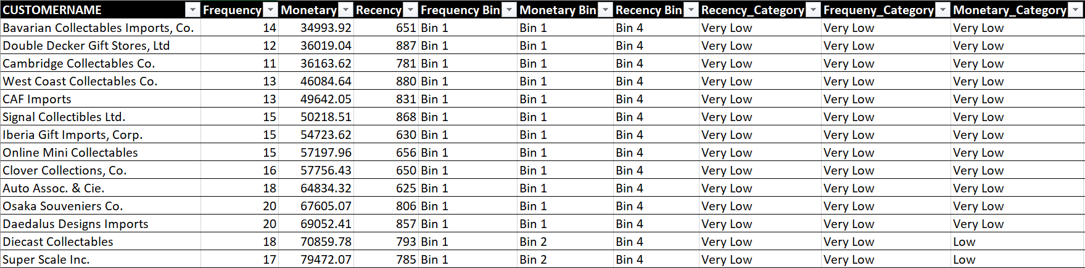
Who are your lost customers? (give at least 5)
There are around 17 customers that the Automobile company has lost.
Such customers have lowest recency, lowest frequency and Monetary category was in the bottom 2 buckets.
Some of them are : -

Slide 31
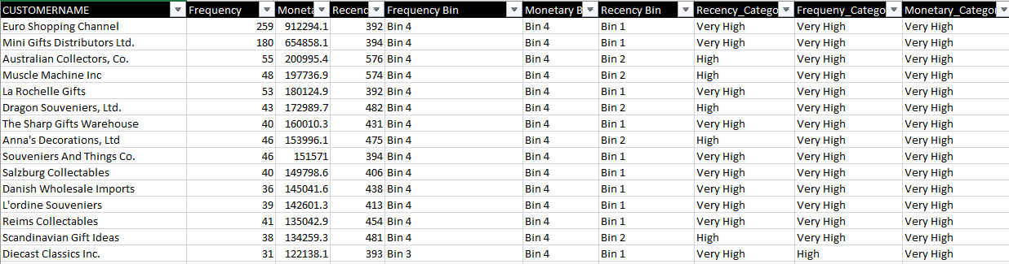
Who are your loyal customers? (give at least 5)
We have around 26 loyal customers (including best customers).
Such customers have higher frequencies and recency.

